Slide 1
Crop classification using deep learning
Team Members Group:81 Panel Number:16
Project Advisor: Dr.S.Padmavathi, Associate Professor(SG) , Department of CSE
SNo | Reg.No | Name of the Student | Section
1 | CB.EN.U4CSE18101 | AADHITH S. | CSE B
2 | CB.EN.U4CSE18118 | HAREESH V. | CSE B
3 | CB.EN.U4CSE18163 | VIGNESH H. | CSE B
4 | CB.EN.U4CSE18173 | THARUN KUMAR A. | CSE B

Slide 2
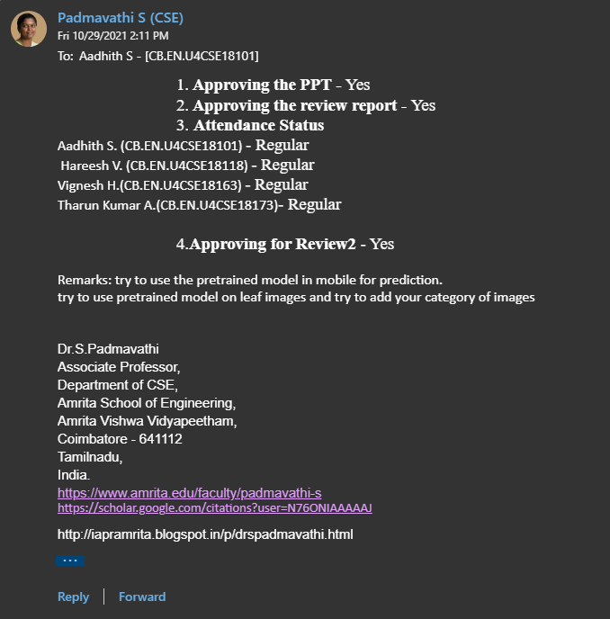
Guide approval mail

Slide 3
Review 1 comments and the actions taken
1. Find out relevant papers of seniors.
One paper by our seniors Niranjana, Nikhil, Sahit and Rohit Varma on Plant leaf disease classification was found. But that too is not so related on our project where we are trying to classify and display the plant details by its leaf.
2. Are you doing intraclass variation?
We have planned to create a model that does only interclass classification.
3. How is your product different from Google Lens?
On giving an image input of a plant, Google lens provides a search result which was highly inaccurate to the desired result. On scanning the leaf image of a lemon tree, Google lens provides results of many other plants like makroot, orange, lemon and the like, but the desired result was to be lemon alone. But our model specifically points out a crop when we provide an input image.
4. Where do you save the ML model, cloud or in the website/mobile app?
We have planned to integrate the ML model in the offline mobile app, to reduce the use of internet and to make it accessible for people anywhere.

Slide 4
Problem statement
Crop identification using deep learning
To develop a web application that would allow users to take images/upload images of different leaves of fruit bearing trees, identifies the tree using Deep Learning and gives some insight on the crop.

Slide 5
Abstract
The modern lifestyle has made people less aware of where we get our food from. From a commoner’s perspective, it may seem irrelevant but it is our responsibility and is necessary knowledge to know where, when, and how our food is being produced. So, we are designing a web-based application where a user can upload an image to gain insight into the crop.
The workflow is as follows, to decide a few couples of crops whose images are abundantly available, to build a deep learning model, to train the same with the datasets, and to build a user interface. We expect this project to give the users more affinity towards farming and pave a path to bring awareness on agriculture as a profession.

Slide 6
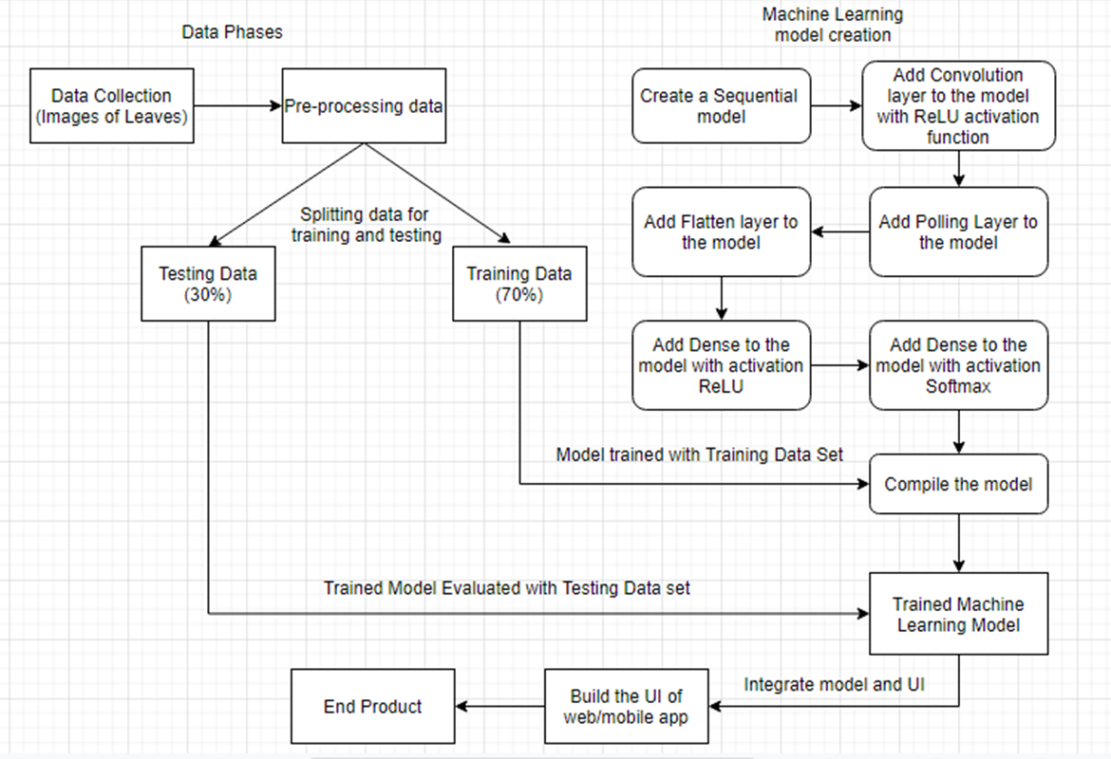
Proposed System
Architecture Diagram:

Slide 7
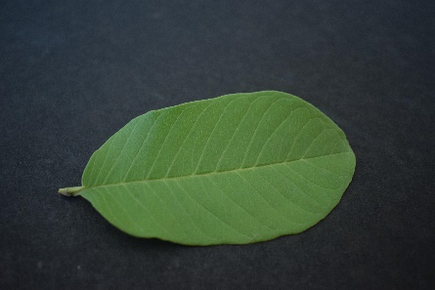
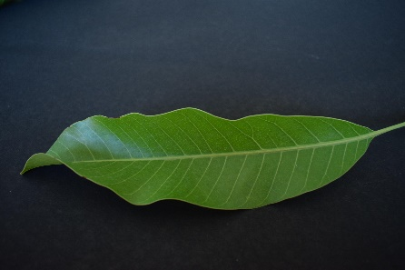
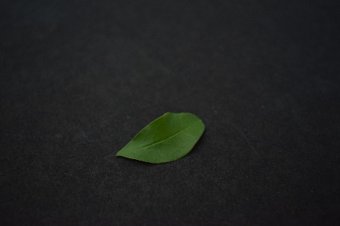
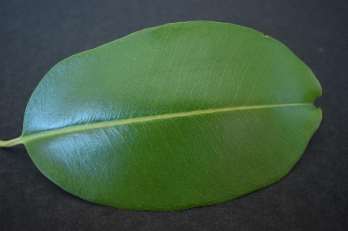
Description of Modules
DATA COLLECTION and DATA PRE-PROCESSING:
This module is the data collection phase of various images to train and test the model.
Further in the pre-processing phase, all the images are being converted to same size and resolution.
Data set link: https://data.mendeley.com/datasets/hb74ynkjcn/1
Sample Images
Guava
Mango
Pomegranate
Jamun

Slide 8
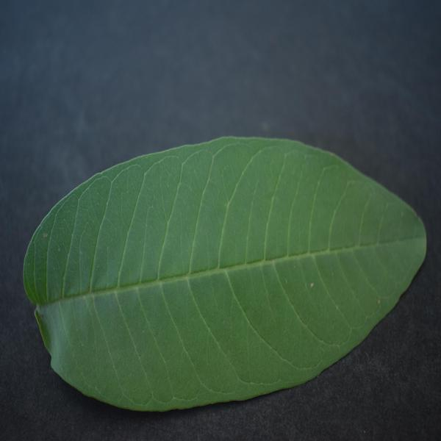
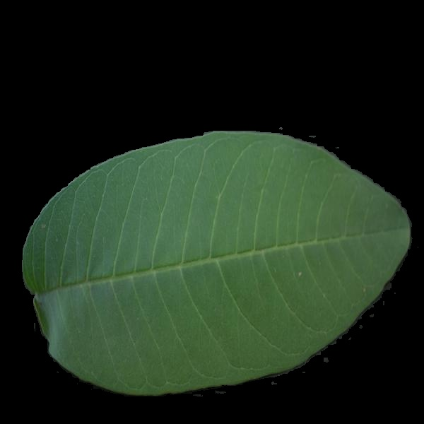
Description of Modules
DATA PRE-PROCESSING :
Background Removal:
We use the cv2 module of python to remove the background.
Input image: Output image:

Slide 9
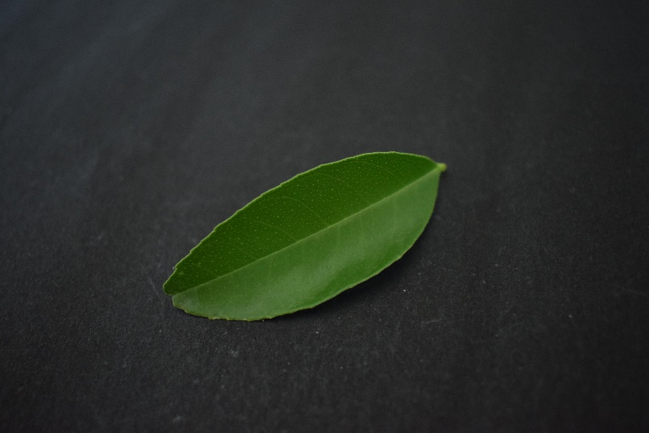

Description of Modules
Resize all Image to same Resolution Python Code :
The input images are of a 6000*6000 pixels resolution, which when directly inputted to the CNN would take a very long time to train. Instead we normalize the size of the input image to 600*600 pixels and then giving it as input to the CNN. We use the PIL module of python to achieve this.
Input image: Output image:
6000*6000 pixels
600*600 pixels

Slide 10
Description of Modules
DATA SPLITTING:
In this module, the data collected (Image of leaves) are being split into training and testing data, where training data is used to train the Machine learning model and the testing data is used to test and evaluate the trained model.
There is a general rule :
70-30 rule where 70% of training data and 30% of testing data.
80-20 rule where 80% of training data and 20% of testing data.
We have chosen 70-30 rule.

Slide 11
Description of Modules
ML MODEL CREATION :
Create a Sequential Model :
Sequential model is a Linear Stack of Layers where we create the model by stacking one layer upon another layer. This model is mostly suited in many deep learning problems. We use sequential model for our use-case since it is simple and easy to create a model and moreover, our model doesn’t require any shared layers and requires only one layer at a time.
To create a sequential model, the following steps are followed:
Instantiate the model
Stack layers using add()
Compile the model

Slide 12
Description of Modules
Add Convolutional Layer :
This layer helps the filter learn and recognize features within the image. It recognizes edges, lines and other distinct shapes within the images. Hence convolutional step is also called Feature Mapping. We will have multiple channels and each channel will be trained to detect certain key features of the image.
The input image obtained is convolved using a filter (kernel) basically of size 3*3 or 5*5. The neural network learns the filter values of the filter that is used to detect the small and important features of the input, to match to the output. the filter (kernel) is glided through the input (receptive field) and element-wise product of the filter and input value is done and finally sum of those specific values is calculated for every sliding action to derive at the output.

Slide 13
Description of Modules
Add Pooling Layer :
The default pool size is (2, 2). We can also add our own pool size. This reduces the number of parameters in our network which is called as down-sampling and makes the model robust to detect features by making it impervious to orient and scale changes.
Pooling layer involves down sampling of the obtained image. That is, the image is shrunk into smaller size. The network is further simplified by reducing the number of parameters. Various steps are involved in this layer. First, window size is selected (ideally 2 or 3). Second, stride is selected (usually 2). [24] Third, iterate the window chosen across the entire image and take the maximum value

Slide 14
Description of Modules
Add Flatten Layer
The 2 dimensional array output after Pooling is flattened and converted into a 1 dimensional single long feature vector and passed as input to the fully connected layer where classification is undergone. Finally Sigmoid, Softmax are some of the activation functions applied to classify the output, in other words, identify the class of the object or image.
Add Dense Layer
Add the fully connected layer using Dense which is the last layer of CNN where neurons in this layer are fully connected with all the neurons of previous layers. Softmax is finally used as activation function for multiclass classification.

Slide 15
Description of Modules
Compiling the model :
Compile defines the loss function, the optimizer and the metrics.
Loss function is used to find error or deviation in the learning process. We use “binary_crossentropy” for our loss function.
Optimization is an important process which optimize the input weights by comparing the prediction and the loss function. We use “Adam” optimizer for our CNN.
Metrics is used to evaluate the performance of your model. We find the reliability of the model using the “accuracy” metric.

Slide 16
Description of Modules
Training and Testing the Model :
In this module, the split training data is used to train the compiled model. The model understands and trains itself with suitable weight values. The trained model is then fed with the testing data such that various metrics of the model can be evaluated.
Finally the UI for the web/mobile app will be created and the Deep Learning model created will be then integrated with the UI so that images can be captured and given such that the model identifies and displays the details of the plant.

Slide 17
References
Sowmya V., Dr. Soman K. P., and Deepika, J., “Image Classification Using Convolutional Neural Networks”, International Journal of Scientific & Engineering Research , vol. 5, no. 6, p. 06/2014, 2014.
Shamsaldin, Ahmed & Fattah, Polla & Rashid, Tarik & Al-Salihi, Nawzad. (2019). The Study of The Convolutional Neural Networks Applications. UKH Journal of Science and Engineering.3.10.25079/ukhjse.v3n2y2019.pp31-40
Arnold, Taylor B.. “kerasR: R Interface to the Keras Deep Learning Library.” J. Open Source Softw. 2 (2017): 296
W. G. Hatcher and W. Yu, "A Survey of Deep Learning: Platforms, Applications and Emerging Research Trends," in IEEE Access, vol. 6, pp. 24411-24432, 2018, doi: 10.1109/ACCESS.2018.2830661.
H. .S and Aarthi, R., “A Survey of Deep Convolutional Neural Network Applications in Image Processing”, International journal of pure and applied mathematics , vol. 118, no. 7, pp. 185-189, 2018.

Slide 18
THANK YOU

